Slide 1
SMART FITNESS BUDDY
IBM AICTE PROJECT
Presented By: Ruturaj
Student name :Ruturaj Barik
College Name & Department :Nalanda Institute Of Technology , Computer Science

Slide 2
OUTLINE
Problem Statement
Technology used
Wow factor
End users
Result
Conclusion
Git-hub Link
Future scope
IBM Certifications

Slide 3
Problem Statement
In today’s fast-paced world, many individuals struggle to maintain a healthy lifestyle due to lack of personalized guidance, time constraints, and inconsistent motivation. Traditional fitness solutions often require expensive subscriptions, in-person consultations, or rigid schedules that don't adapt to personal preferences or daily routines.
Proposed Solution: Smart Fitness Buddy is a virtual AI-powered fitness coach built on IBM Cloud to deliver scalable, secure, and intelligent health support. The solution uses IBM Watsonx.ai and Granite language models to generate personalized workout and nutrition plans, motivational responses, and adaptive fitness recommendations based on user inputs.

Slide 4
Technology used
IBM cloud lite services
Natural Language Processing (NLP)
Retrieval Augmented Generation (RAG)
IBM Granite model

Slide 5
IBM cloud services used
IBM Cloud Watsonx AI Studio
IBM Cloud Watsonx AI runtime
IBM Cloud Agent Lab
IBM Granite foundation model

Slide 6
Wow factors
Personalized fitness and diet guidance using IBM Watsonx.ai with Granite foundation models.
Prompts are fine-tuned to deliver responses that match the user's tone, goals, and daily mood.
Automatically modifies workouts and meals based on performance, preferences, or schedule changes.
Deployed on IBM Cloud with scalable backend, object storage for user data, and optional App ID for authentication.
Designed for easy upgrades — future support for wearables, food photo analysis, voice interface, and more.
Goes beyond fitness with motivational messages, habit tracking.

Slide 7
End users
Busy professionals who need quick fitness guidance without wasting time.
Students and beginners seeking affordable, AI-based coaching instead of hiring trainers.
Fitness enthusiasts who want smarter tracking, adaptive plans
Seniors or wellness-focused users who need safe, guided routines

Slide 8
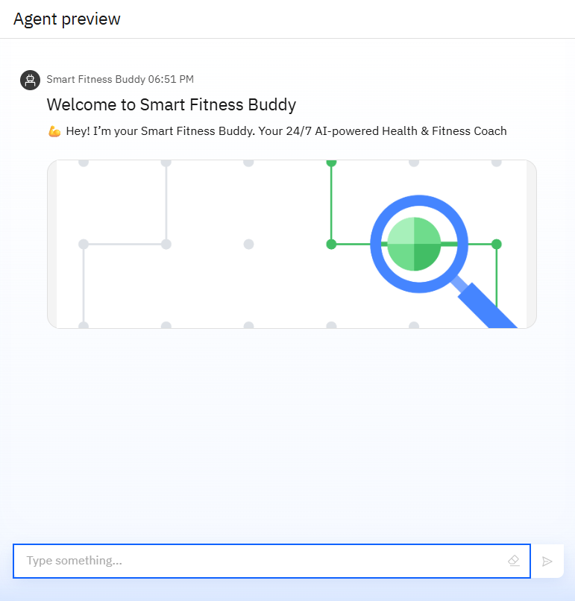
Results

Slide 9
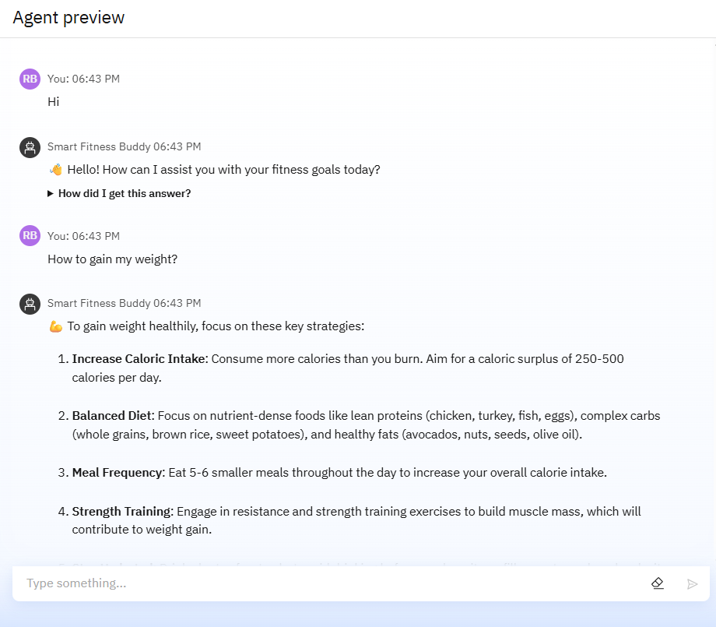
Results

Slide 10
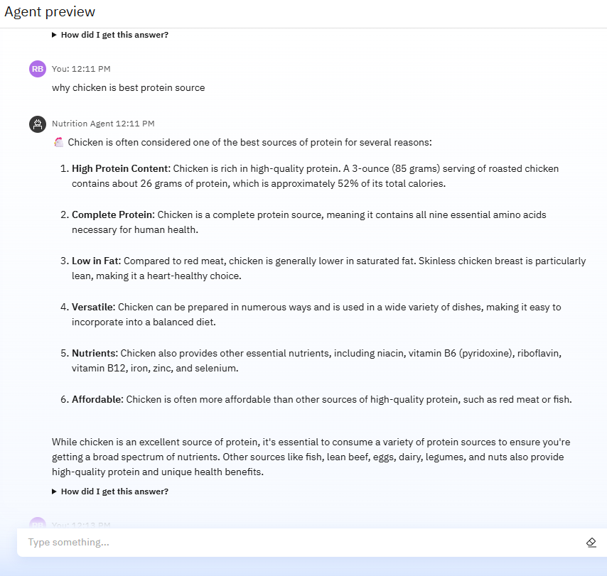
Results

Slide 11
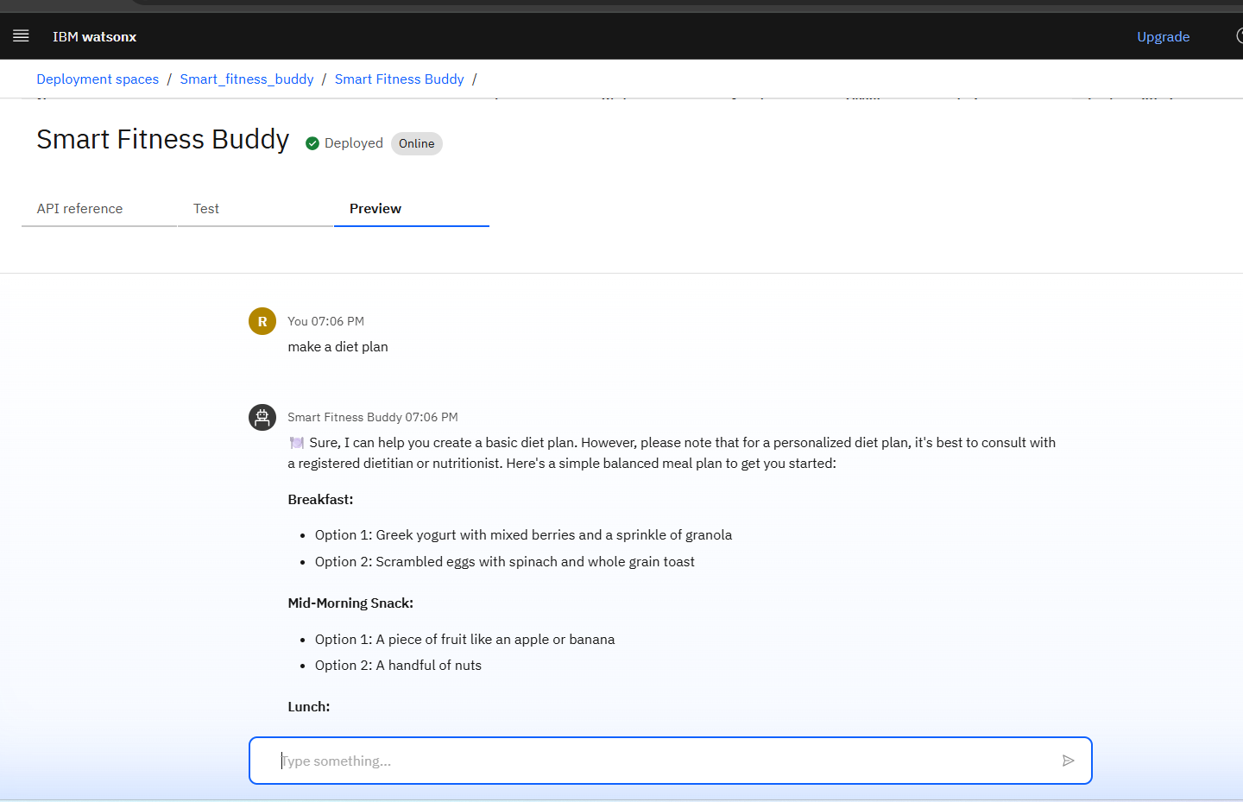
Results
Deployed AI Agent

Slide 12
Conclusion
Smart Fitness Buddy is a powerful AI-driven fitness assistant designed to make health and wellness more accessible, personalized, and motivating.
By leveraging IBM Cloud, Watsonx.ai, Prompt Lab, and Granite models, it delivers real-time, adaptive workout and nutrition guidance tailored to each user’s lifestyle.
It removes barriers like cost, time, and lack of expert support—turning smartphones into 24/7 fitness companions.

Slide 13
Future scope
Expand accessibility with AI conversations and coaching in regional languages.
Enable users to talk to their AI fitness coach hands-free.
Integrate with Apple Watch, Fitbit, Google Fit, etc., for real-time activity and health data.
Use image recognition to analyze user-submitted meal photos and provide instant nutrition feedback.
Add stress tracking, breathing exercises, and mood-based fitness recommendations.

Slide 14
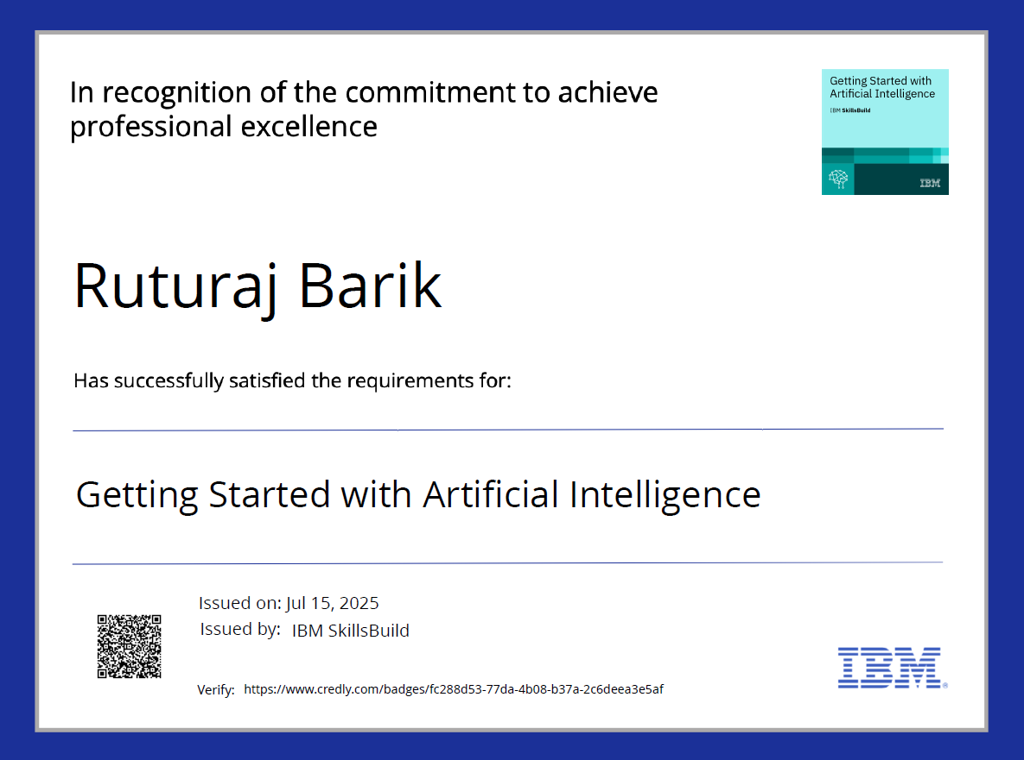
IBM Certifications
( getting started with AI)

Slide 15
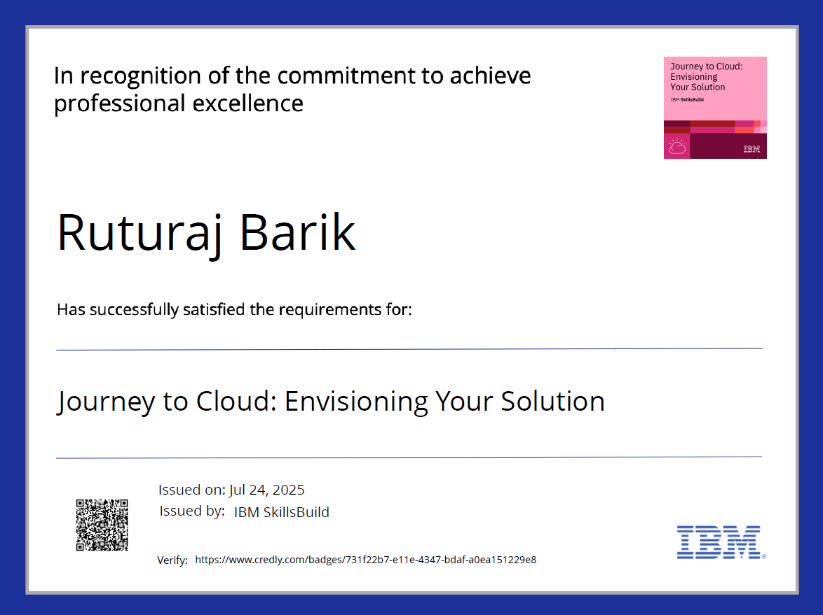
IBM Certifications
( journey to cloud)

Slide 16
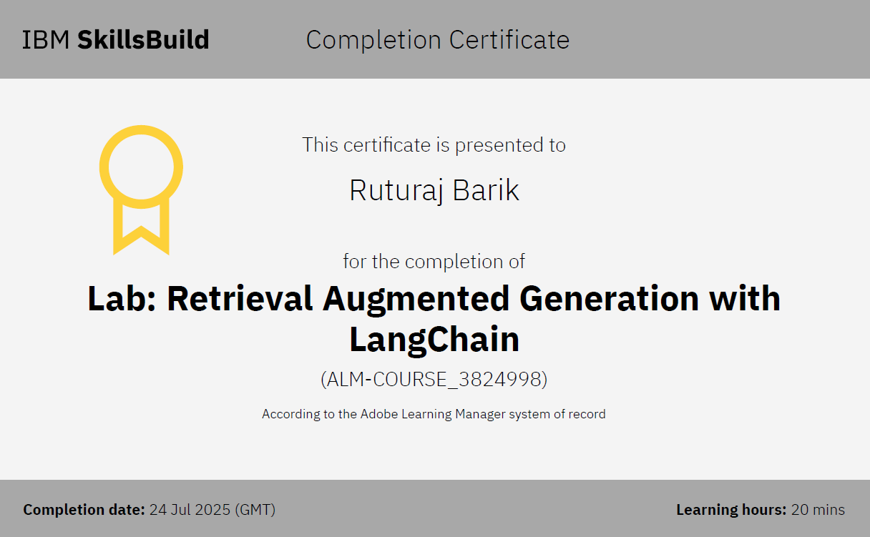
RAG LAB certificate:

Slide 17
Git hub lik : https://github.com/ruturaj45/Smart-Fitness-Buddy

Slide 18
THANK YOU

